Slide 1

Analysis of Spotify Million Playlist DATASET Challenge
Nguyen Ly
MATH 448
5/17/2021

Slide 2

Research Questions
What variables increase the popularity of a song?
What is the effect of a track’s popularity on the number of Spotify playlist a track is in?
Does having a high playlist and follower count influence an artist’s popularity?
Notes:
My project wants to look at user interaction and music recommendation based on public playlists made by Spotify users in the million playlist dataset challenge. Since this is such a broad question, I want to look at metrics that can be use to quantify user interaction and music recommendation through playlists which will be explored using these questions, specifically artist’s success in followers, playlist count, and popularity scores.

Slide 3

Data Sources
Spotify Million Playlist Dataset
Kaggle Spotify Dataset 1922-2021, ~600k Tracks
Sources:
https://www.kaggle.com/yamaerenay/spotify-dataset-19212020-160k-tracks
https://www.aicrowd.com/challenges/spotify-million-playlist-dataset-challenge#dataset
Notes:
cleaned data from around 2.2 million tracks to around100k tracks in the dataset, and from 298k artists to 113k artists in the dataset

Slide 4
What variables increase the popularity of a song?

Slide 5
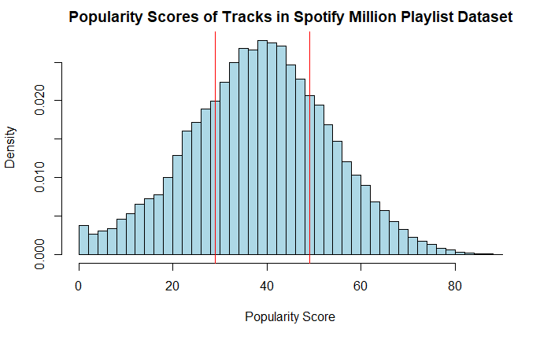
Some Descriptive Statistics
Median: 39
Mean: 38.92942
Standard Deviation: 14.81091
n: 113051
Min: 0
Q1: 29
Q3: 49
Max: 90

Slide 6
Correlation Between Popularity and the 11 Numerical Variables.
Variables | Correlation to Popularity | Cor.Test P-value | 95% Confidence Interval
count | 0.3305338 | 2.2e-16 | (0.3322173,0.3425487)
popularity | 1.0000000 | n/a | n/a
danceability | 0.1676688 | 2.2e-16 | (0.1625810, 0.1739094)
energy | 0.2778534 | 2.2e-16 | (0.2723210, 0.2830804)
loudness | 0.3451695 | 2.2e-16 | (0.3407502, 0.3510139)
speechiness | 0.0478933 | 2.2e-16 | (0.04209035, 0.05372206)
acousticness | -0.3172420 | 2.2e-16 | (-0.3228308,-0.3123483)
instrumentalness | -0.1760148 | 2.2e-16 | (-0.1821274, -0.1708320)
liveness | -0.0264352 | 2.2e-16 | (-0.03287435, -0.02122440)
valence | 0.0054542 | 0.08202 | (-0.0006568744, 0.0110012881)
tempo | 0.0579349 | 2.2e-16 | (0.05142450, 0.06304479)
duration_min | 0.0077919 | 0.01657 | (0.001296902, 0.012954784)
Notes:
There is a moderate degree of correlation between popularity and three other variables: count, loudness, and acousticness.
There is a moderate positive degree of correlation between popularity and 2 variables.
These are count and loudness with a correlation of 0.331 and 0.345 respectively.
Also notable is the correlation between popularity and energy. Although low, it has a correlation coefficient of 0.278.
Correlation Test between popularity and valence/duration_min. Accept the null hypothesis for valence at an alpha level of 0.05 and duration_min at an alpha level of 0.01 that the true correlation coefficient is equal to 0.

Slide 7
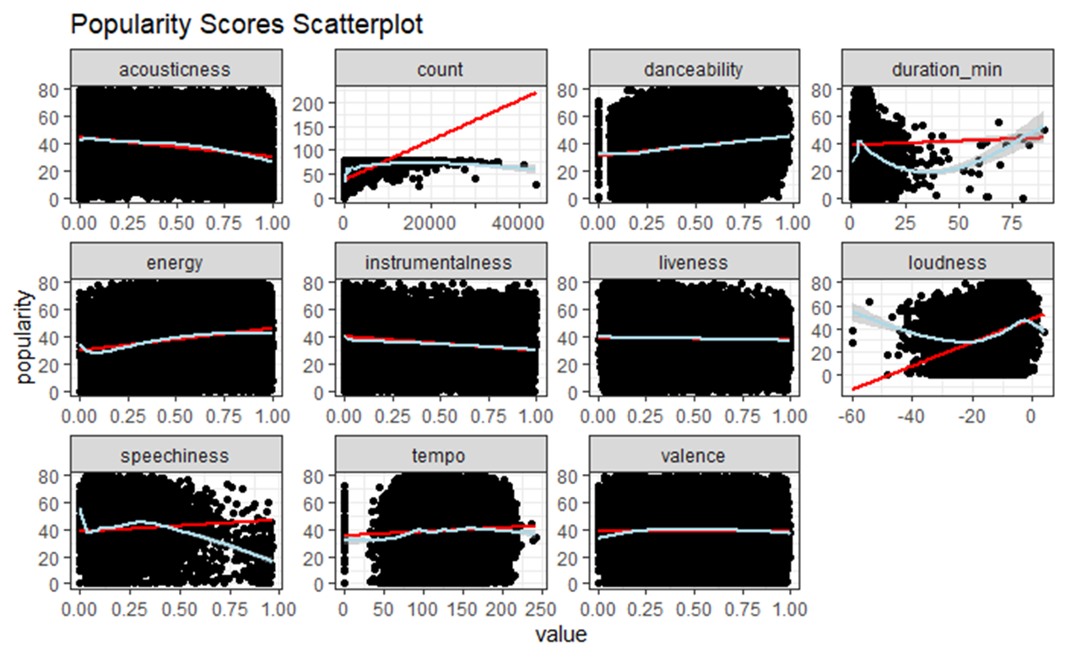
Notes:
Lines in blue are generalized additive models which adapts the curve to the data and lines in red are the linear model of the data.
Most of these variables are linear except count, duration_min, loudness, and speechiness.
However, count and loudness have a highest correlation coefficient.

Slide 8
What is the effect of a track’s popularity on the number of Spotify playlist a track is in?

Slide 9
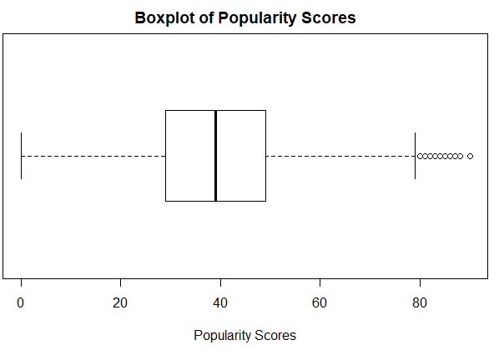
Contingency table of popularity scores and playlist count, with columns being Spotify popularity scores and rows being playlist counts.
 | Low | Medium | High | High Outlier
Low | 15917 | 16910 | 1959 | 0
Medium | 10599 | 32331 | 6824 | 2
High | 426 | 9883 | 18017 | 183
Percentage Contingency table of popularity scores and playlist count, with columns being Spotify popularity scores and rows being playlist counts.
 | Low | Medium | High | High Outlier
Low | 59.08 | 28.60 | 7.31 | 0.00
Medium | 39.34 | 54.68 | 25.46 | 1.08
High | 1.58 | 16.72 | 67.23 | 98.92
Notes:
Categorization of popularity scores based on IQR.
Values below Q1 will be categorized as low(0-28). Values between Q3 and Q1 will be categorized as mid (29-49), and values above Q3 will be categorized as a high(50-79). Outliers are categorized as high outlier(80-100).
Playlist count is also based on IQR. A low playlist count is between 1 and 2 playlists. A medium playlist count is between 3 to 37 playlists, and a high playlist count is between 37 to 46574 playlists
Points out percentages of interest, specifically in high/high outlier popularity scores with high playlist counts and low popularity scores with low playlist counts.
A track with high popularity scores (which are scores between 50 to 100) is 15 times more likely to have a high playlist count than a track with a mid to low popularity score
Conducted a Chi Square test of independence, and the p-value is <2.2e-16 which is less than the p-value. We reject the null hypothesis. The data suggests that popularity score is not independent of playlist count.

Slide 10
Does having a high playlist and follower count influence an artist’s popularity?
Notes:
Previously discussed dependency between popularity scores and playlist count. Would an increase in playlist count and follower count influence an artist’s popularity, assuming that popularity score is an indicator of interaction with an artist?

Slide 11
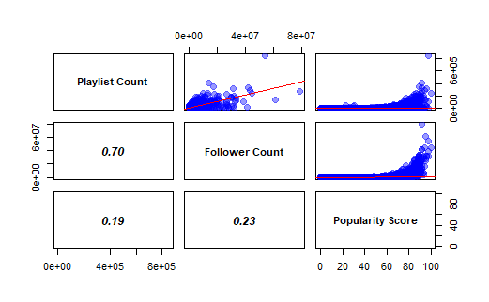
Proportion table of an artist’s popularity score versus their follower count. The rows represent follower count, and the columns represent popularity score.
 | Low | High
Low | 0.921 | 0.2149
High | 0.079 | 0.7851
Proportion table of an artist’s popularity score versus their playlist count. The rows represent playlist count, and the column represent popularity score.
 | Low | High
Low | 0.8678 | 0.3853
High | 0.1322 | 0.6147
Notes:
Note the high correlation between playlist count and follower count.
Again, the categorization is based on IQR but anything above Q3 is categorized as high and below Q3 is categorized as low.
Artists with a high popularity score are 10.47 times more likely to have a high playlist count than artists with low popularity scores.
The relative likelihood for an artist with a high popularity score to have a high playlist count is 9.94 times the likelihood of an artist with a low popularity score to have a high playlist count.
Artists with a higher popularity score are 42.59 times more likely to have a high follower count than artists with a low popularity count.
The relative likelihood for an artist with a high popularity score to have a high follower count is 4.65 times the likelihood that an artist with a low popularity score to have a high follower count.

Slide 12
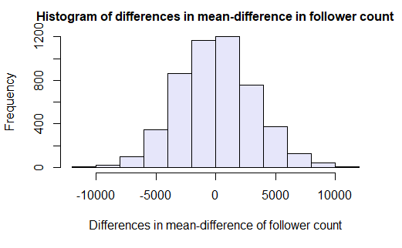
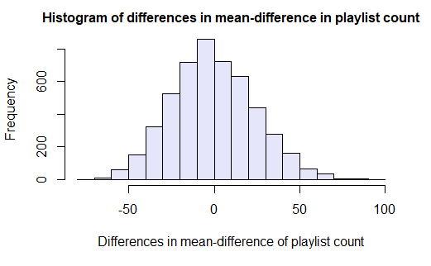
Notes:
Two permutation tests, one for playlist count and one for follower count to compare if the differences in these proportions equal through resampling of the dataset.
Difference in mean for playlist count based on artist popularity score (high or low) is 1272.685 playlists. Differences in means for follower count is at 204,527.6 followers.
In both cases, the p-value is statistically significant at the 1% significance level. This suggests that the probability of having a higher playlist count is higher for artists with high popularity scores than artists with low popularity scores and the probability of having a higher follower count is higher for artists with high popularity scores than artists with low popularity scores.

Slide 13
Summary
Of the 11 numerical variables, playlist count and loudness have the highest value of positive correlation to popularity, with a correlation coefficient of 0.331 and 0.345 respectively.
A track that has a high popularity score ranging from 50 to 100, is 15 times more likely to have a high playlist count than a track with a mid to low popularity score.
Based on the Chi-Square Test of Independence, the p-value is statistically significant. Therefore, the popularity score is not independent of playlist count.
Having a high popularity score also mean that an artist will have a higher probability of having a high follower count and high playlist count, assuming follower count and playlist count are metrics for user's interactions with an artist.
Artists with a high popularity score are 10.47 times more likely to have a high playlist count than artists with low popularity scores. Artists with a higher popularity score are 42.59 times more likely to have a high follower count than artists with a low popularity count.
Using the permutation test, it is determined that the probability of having a higher playlist count is higher for artists with high popularity scores than artists with low popularity scores, and the probability of having a higher follower count is higher for artists with high popularity scores than artists with low popularity scores.
Notes:
Now that I can use a track’s/artist playlist count, follower count, and popularity score as a metrics for user interaction and recommendation, I can use this information for future work.
Future work, does average position of a track in a playlist mean for user interaction.
What does this mean for the demographics of users who use Spotify since 74% of users are between 18-34 years old. Explore about artist genre and playlist titles as well.
age prop
18-24 0.43
25-34 0.31
35-44 0.09
45-54 0.04
55+ 0.03
other 0.10

Slide 14
QUESTIONS

